Slide 1

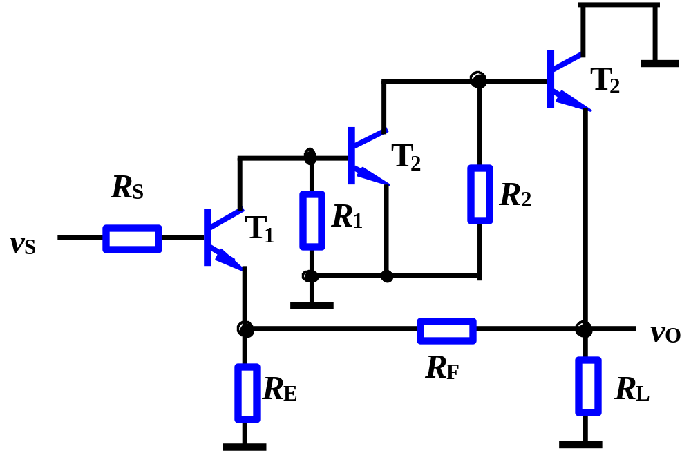
Exercises
Determine the feedback configuration
1.
Series
Shunt
Series-shunt neg.

Slide 2
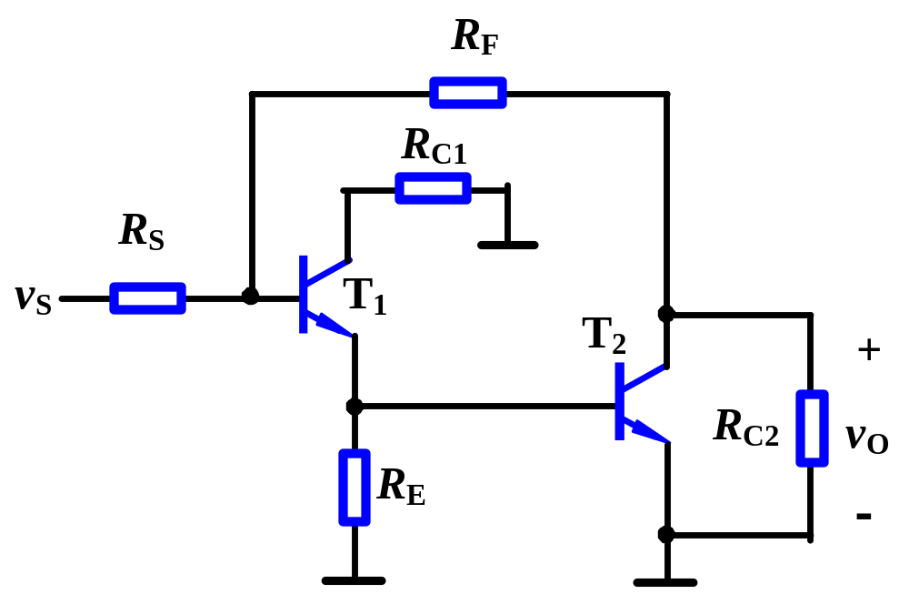
Exercises
2.
Shunt
Shunt
Shunt-shunt neg.

